Slide 1
1. 5 D A T A S C I E N C E D E M O
s
S r i r a m - I T E x p e r t
Y o u t u b e C h a n n e l : I n t e l l e c t S r i r a m

Slide 2
Understanding Data Science

Slide 3
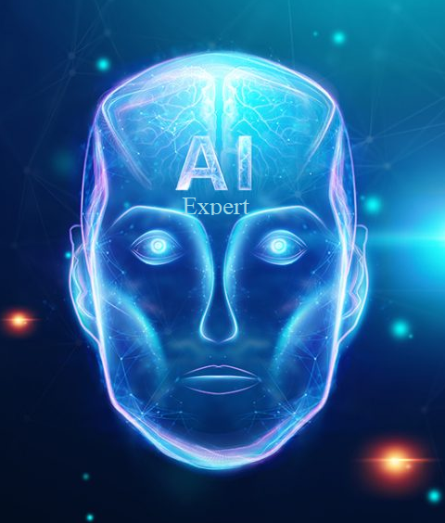
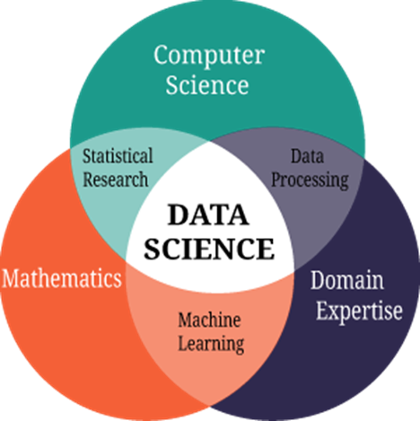

What is Data Science?
Welcome Data Science Expert
Data Science is a mixed discipline, which involves the use of statistics, computer science and Domain Knowledge.
Extracts information out of data by performing analysis on the same
Dhanurjay "DJ" Patil is an American mathematician and computer scientist who served as the Chief Data Scientist of the United States under Barak Obama healthcare functions. Coined the word “Data Science” in 2008
William S is the father of Data Science in 21st Century

Slide 4
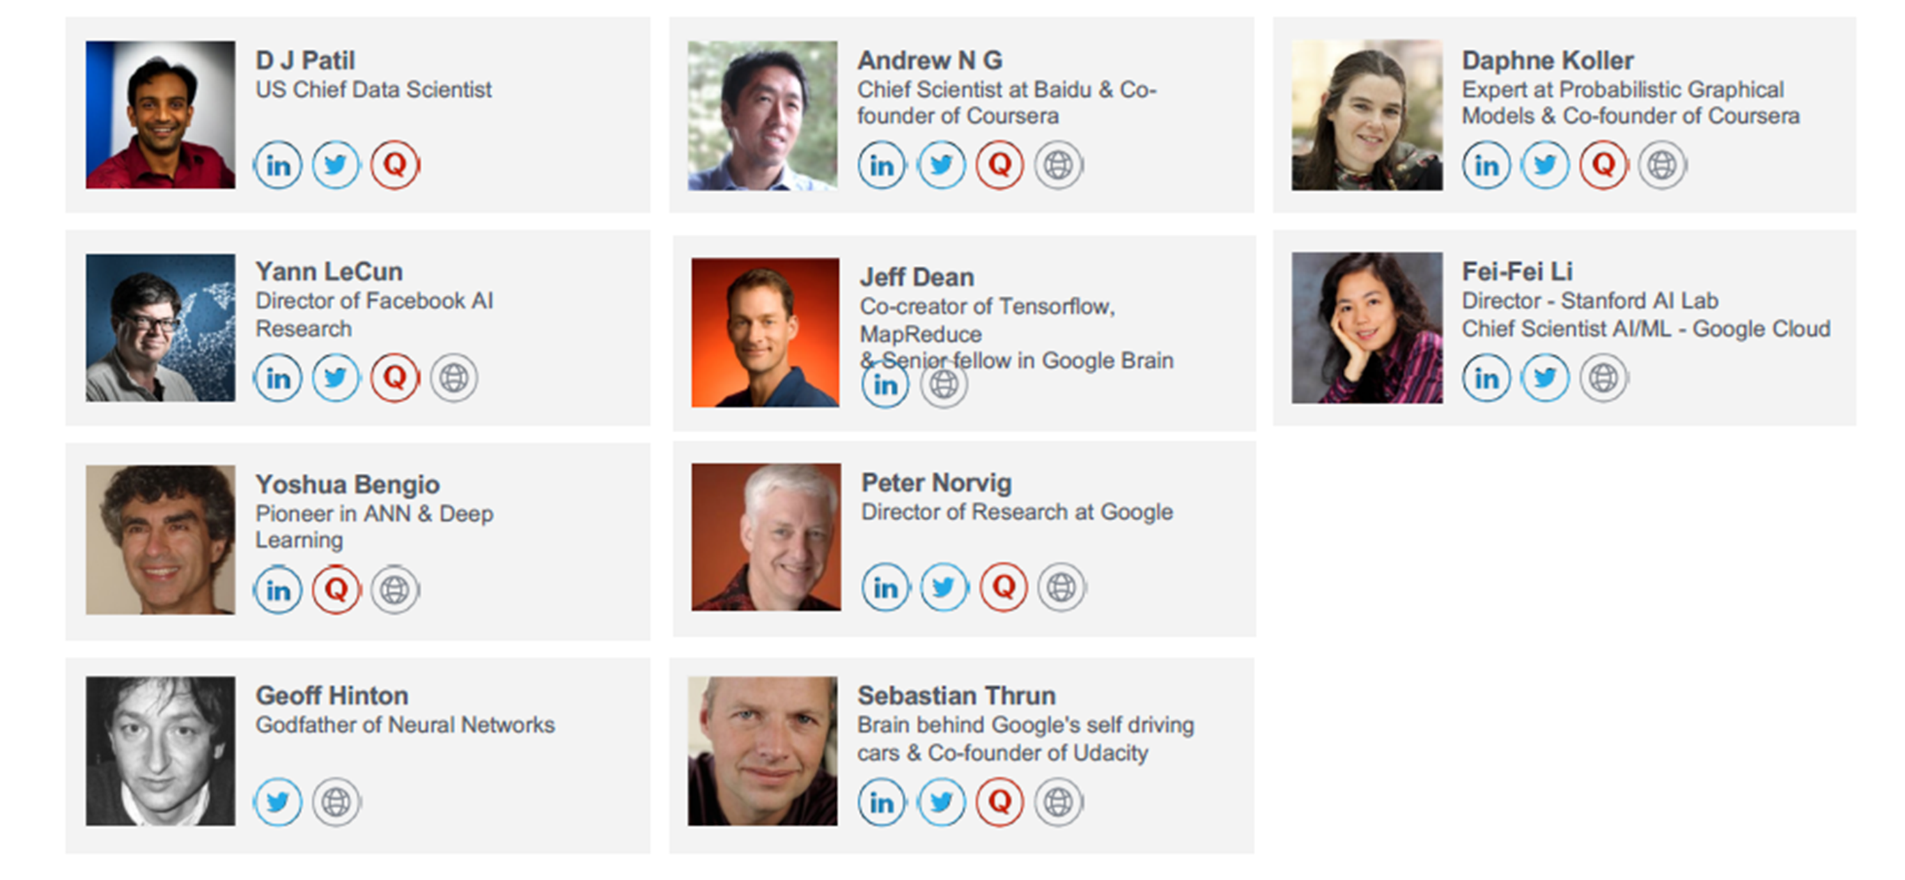
Data Science Expert
Welcome Data Science Expert

Slide 5
Skills needed for Data Science
Welcome Data Science Expert
What would organizations like to look for when they evaluate you as a potential Data Scientist?
You need knowledge of all 3 domains to build effective analytics solutions
Statistical Knowledge –> Design & Build the best algorithm
Business Understanding –> Derive actionable business insights
Information Technology – >Gather & Store data, Deploy Solution using Python, R, SAS

Slide 6
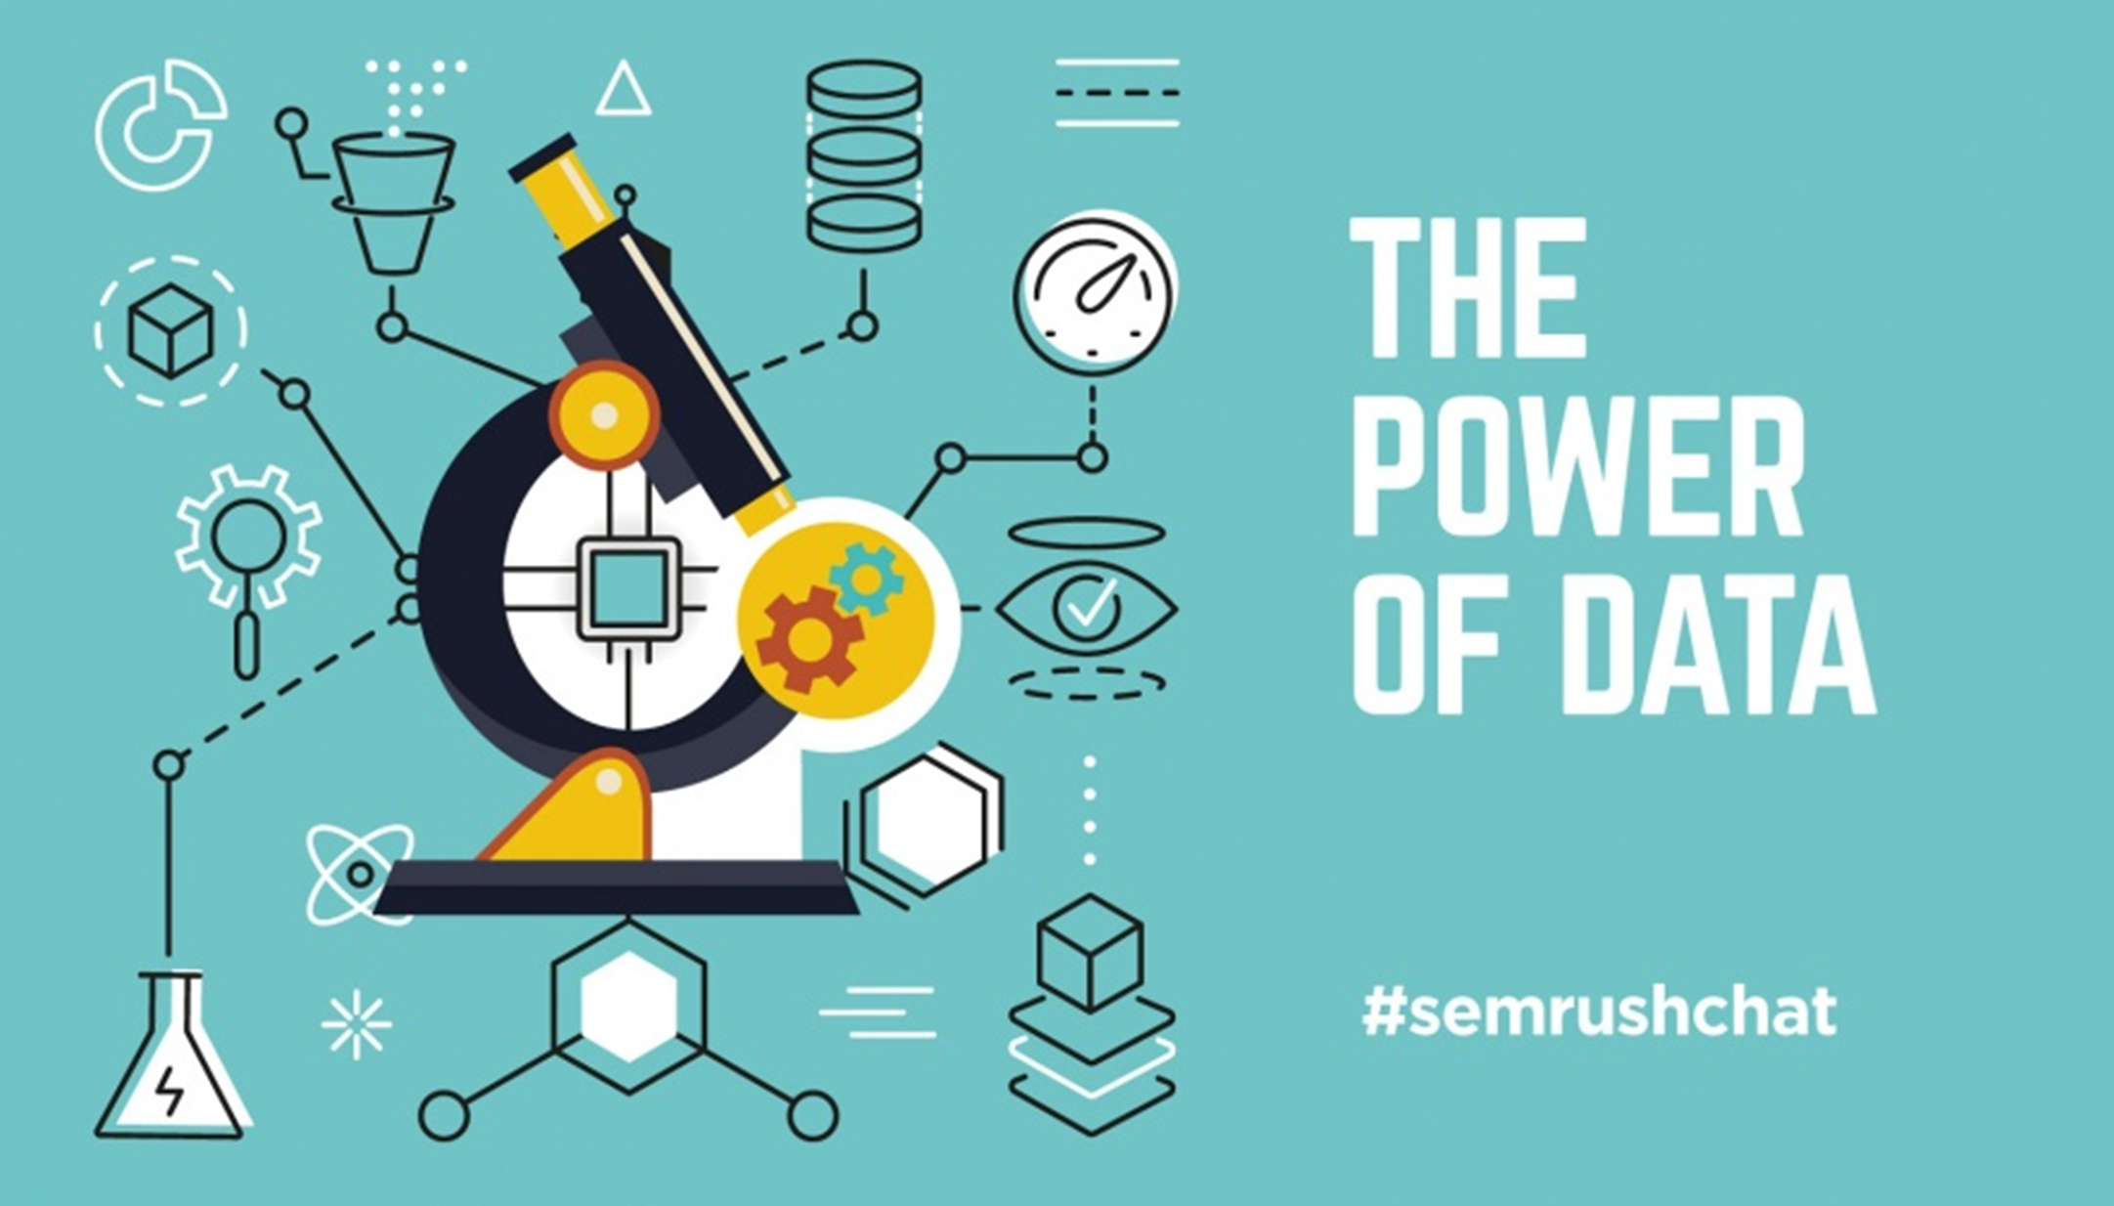
Data Science is the power of Data
Welcome Data Science Expert
a

Slide 7
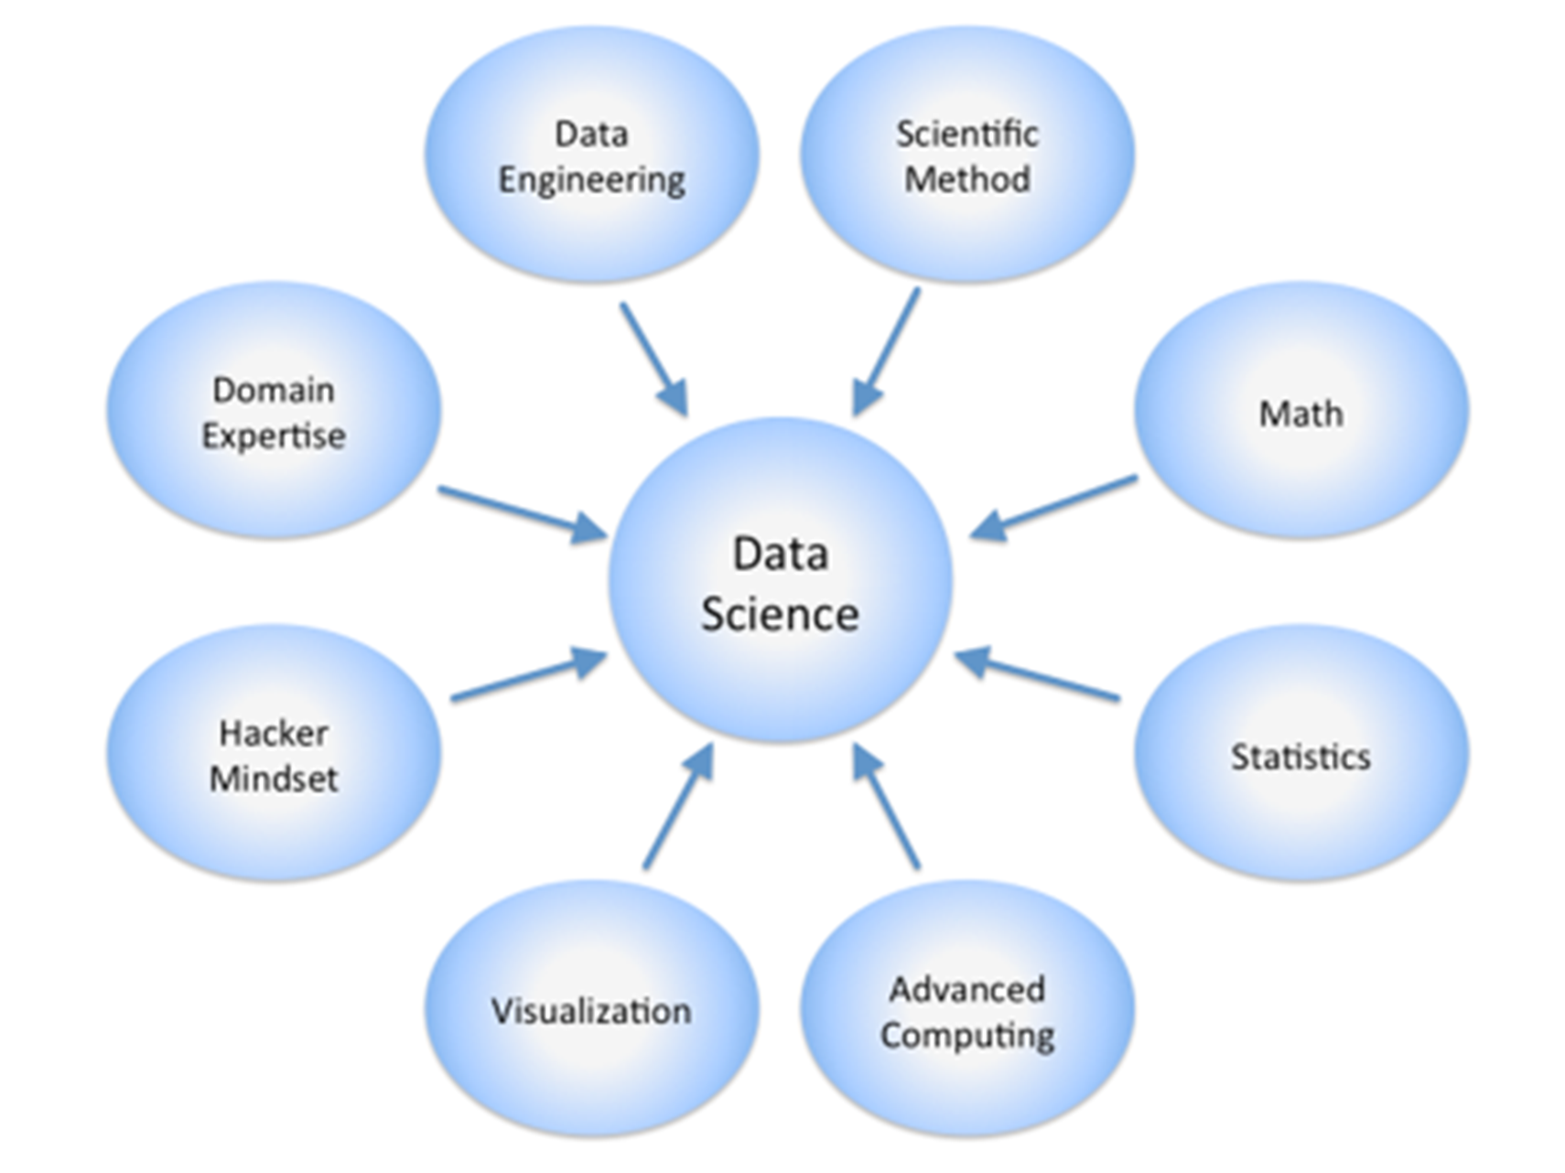
Data Science Deals with
Welcome Data Science Expert

Slide 8
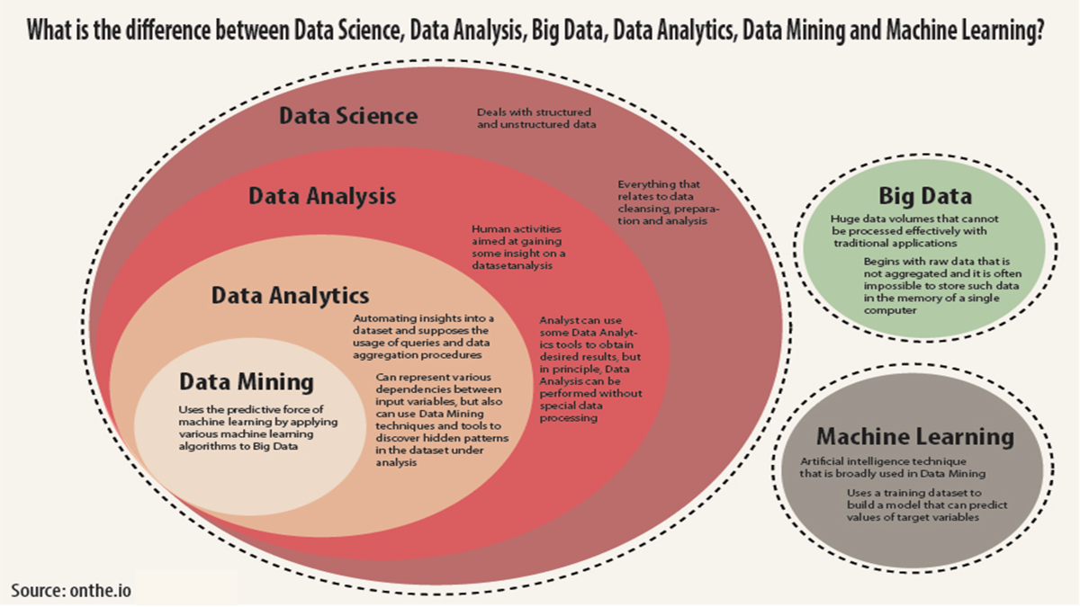
Differences: Data Science, Data Analysis, Data Mining & ML
Welcome Data Science Expert

Slide 9
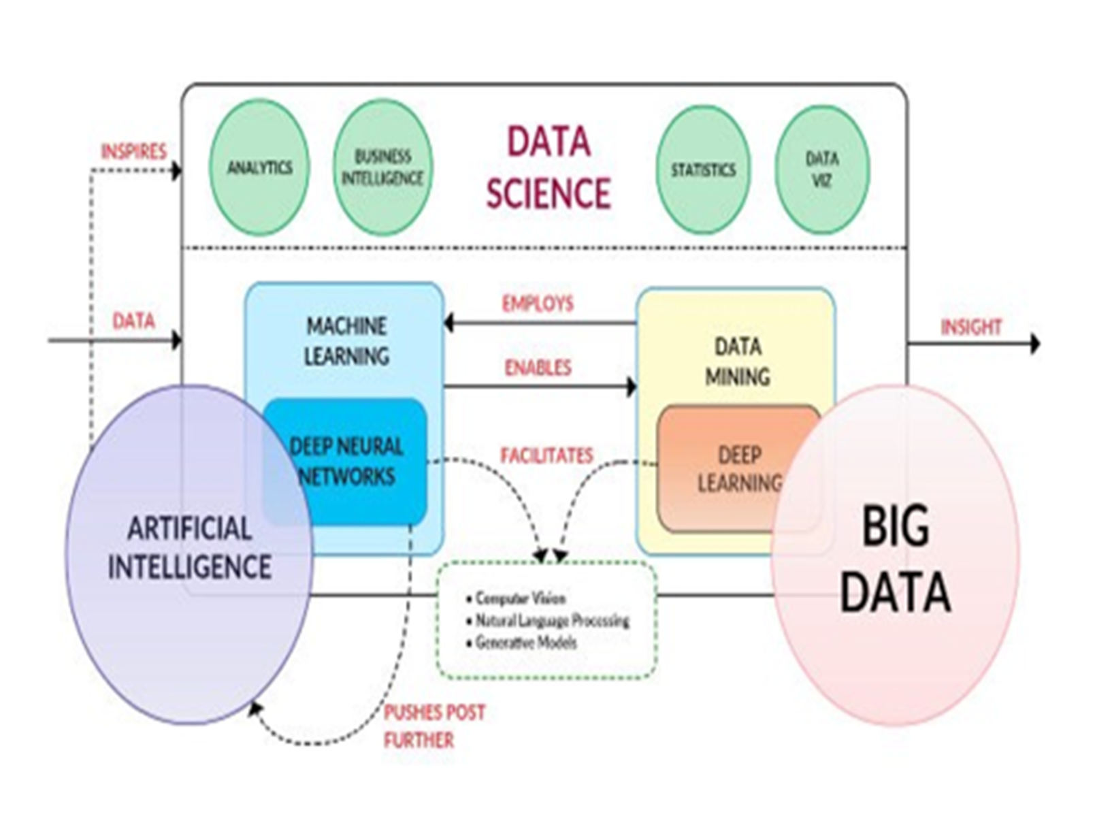
Data Science – Neighborhood Technologies
Welcome Data Science Expert

Slide 10


Slide 11
Data Science Process
Welcome Data Science Expert

Slide 12
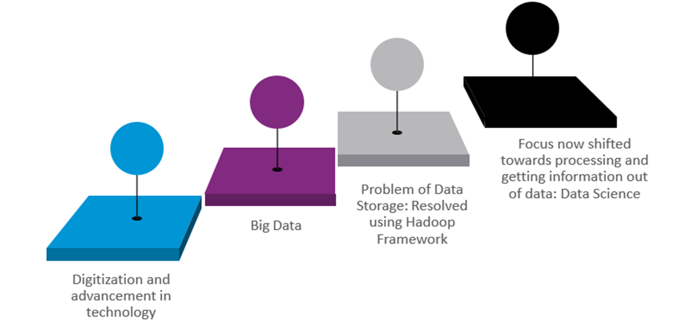
Why the world needs Data Science?
Welcome Data Science Expert

Slide 13
What Data Scientist do?

Slide 14
Roles of a Data Scientist
Welcome Data Science Expert
Responsible for designing and creating processes and layouts for complex, large-scale data sets used for modelling, data mining, and research purposes
Selecting features, building and optimizing classifiers using ML techniques
Data mining using state of the art methods
Extending company’s data with third party sources of information when needed
Processing, cleansing and verifying the integrity of data for analysis
Building predictive models using ML algorithms

Slide 15
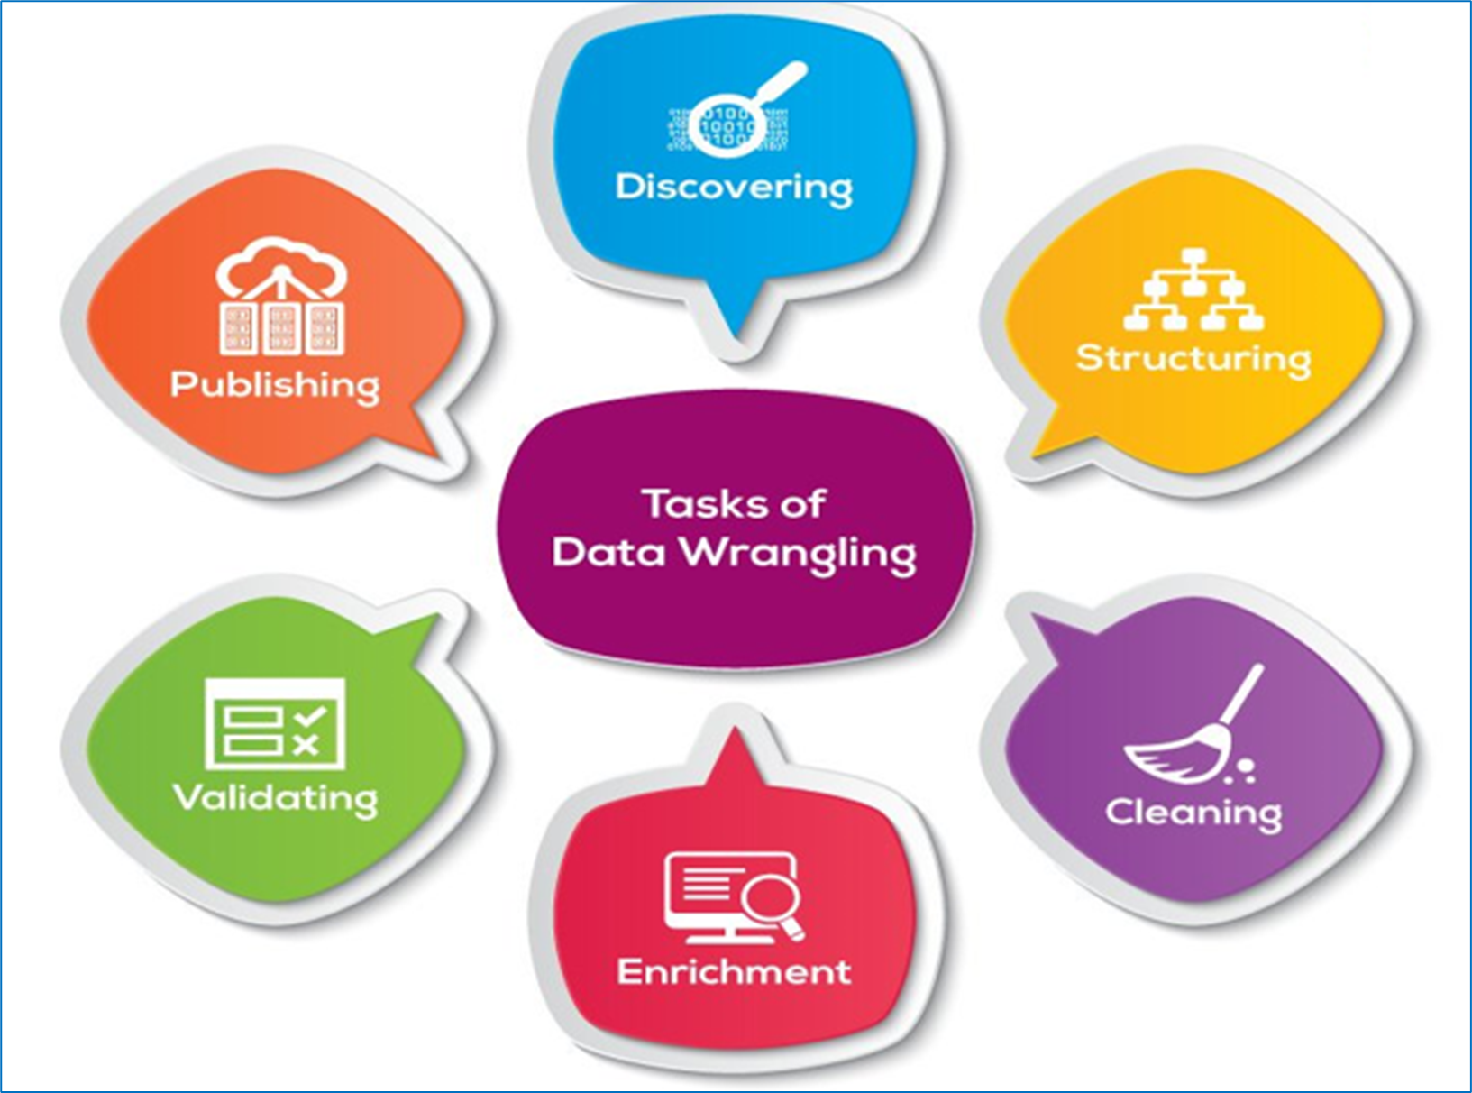
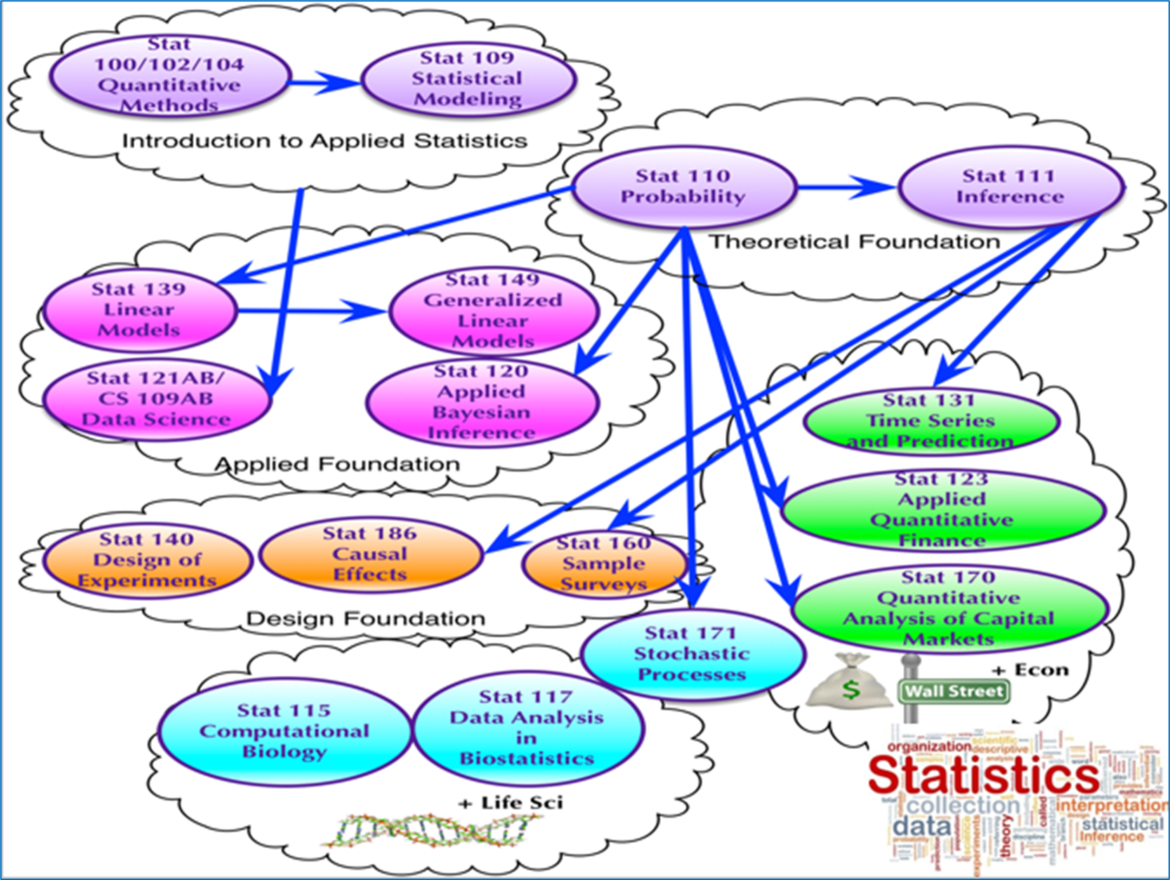
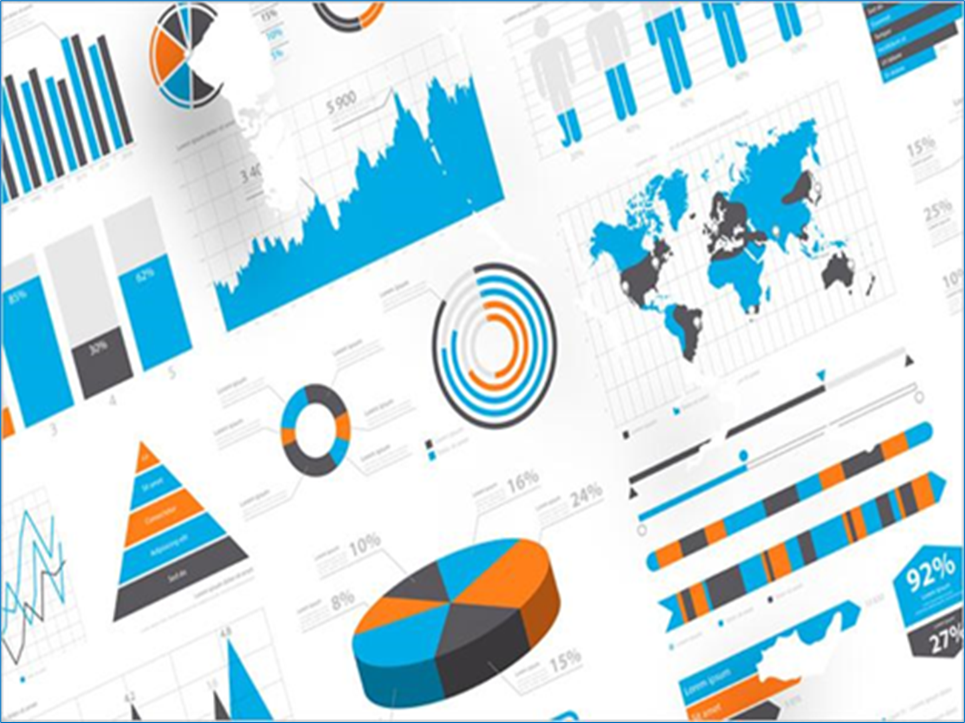
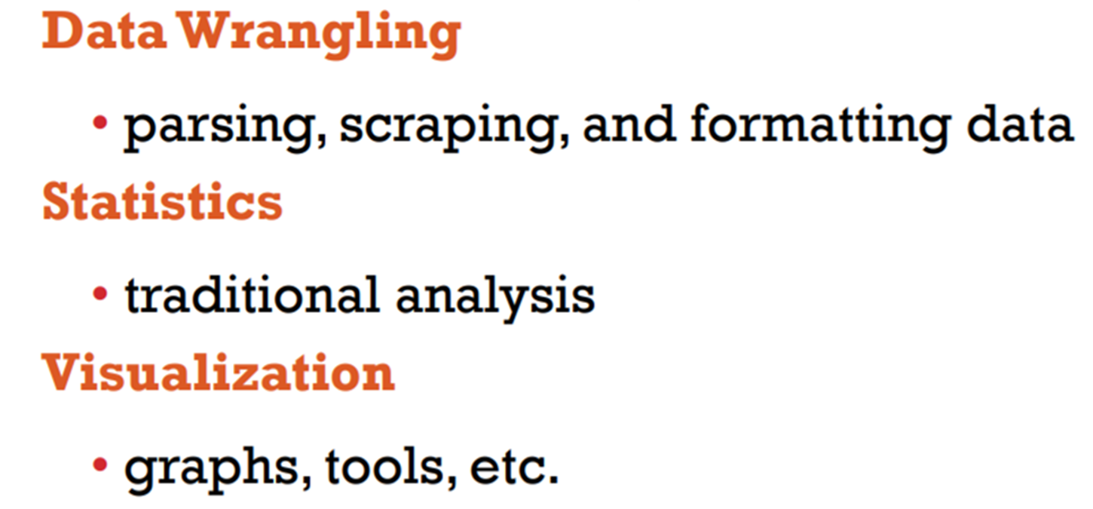
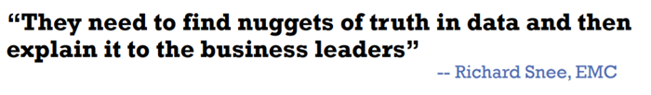
What Data Scientist do?
Welcome Data Science Expert
Data Wrangling
Statistics
Visualization

Slide 16
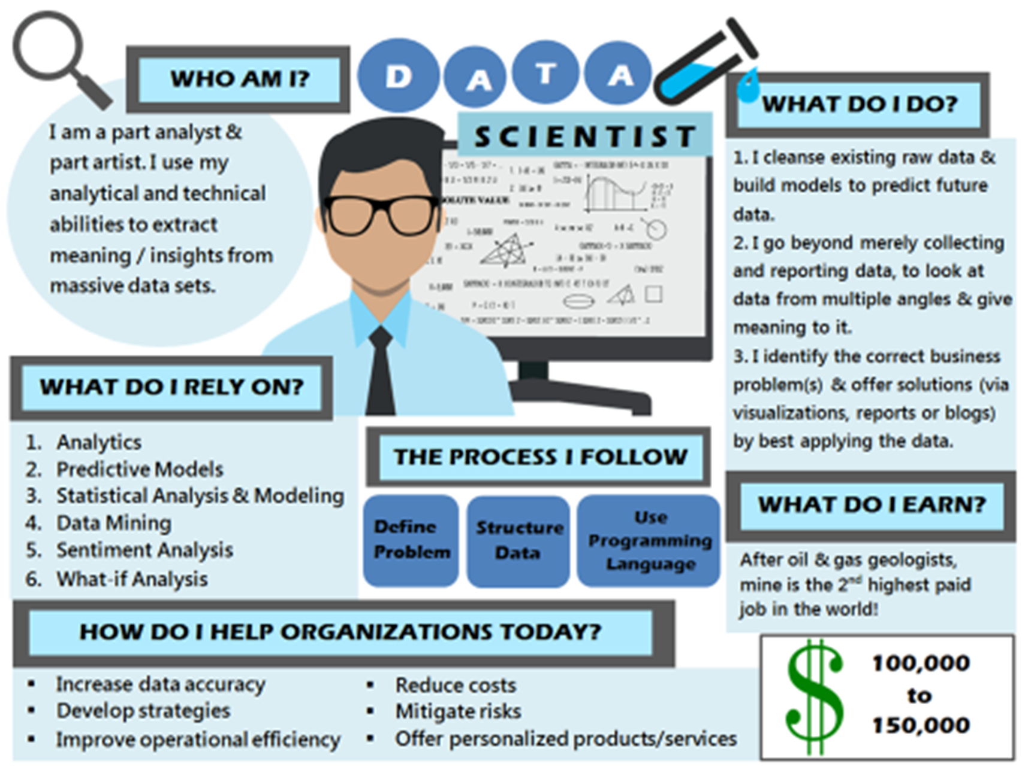
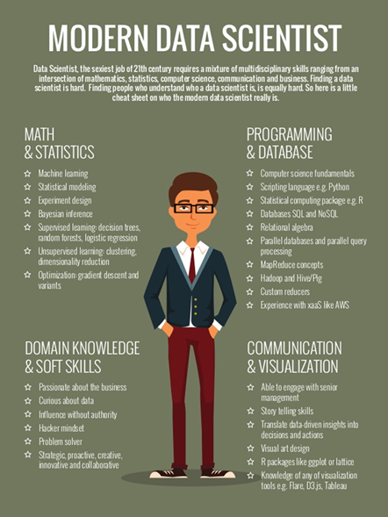
Modern Data Scientist – What do I do?
Welcome Data Science Expert

Slide 17








Tools for Data Science
Data Science Expert
Python Libraries
Web Framework | Desktop Tools

Slide 18
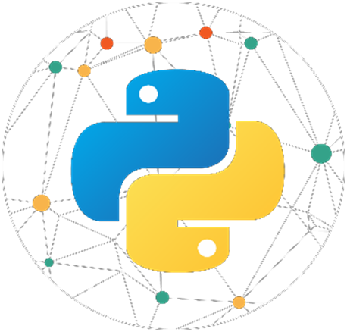


Data Science Technologies
Data Science Expert
Python
Statistics
Machine Learning

Slide 19
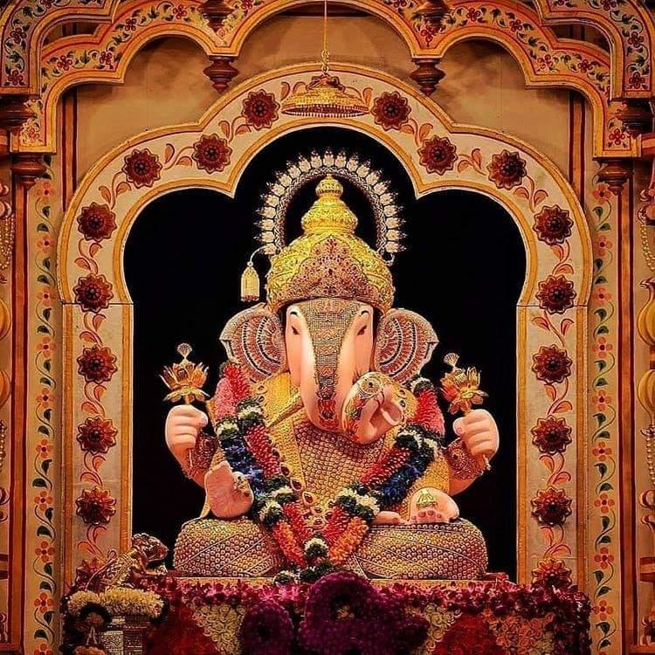

T h a n k Y o u !
I n t e l l e c t S r i r a m
Subscribed
LinkedIn : https://www.linkedin.com/in/sriram-balasubramanian-374566166/
GitHub : https://github.com/intellectsriram

